Slide 1
Isolation Forest
Presented by Cameron Fincher

Slide 2
Publication Details
Paper Title: Isolation Forest
Authors:
Fei Liu (Gippsland School of Information Technology, Australia)
Kai Ting (Gippsland School of Information Technology, Australia)
Zhi-Hua Zhou (National Key Laboratory for Novel Software Technology, China)
Published in the Proceedings of the 8th IEEE International Conference on Data Mining, pages 413–422, Pisa, Italy, 2008

Slide 3
Table of Contents
Section 0: Summary of Isolation Forest
Section 1: Anomalies, what are they? How do we find them?
Section 2: Technical Overview of Isolation Trees and Isolation Forest
Section 3: Results
Section 4: Discussion

Slide 4
Section 0: Summary of Isolation Forest
(Or the elevator pitch of Isolation Forest)

Slide 5
60 second overview
An Isolation Tree (iTree) is built by recursively applying a random split on a random variable to isolate all data points from a subsample of the data set. Multiple iTrees are built to form an Isolation Forest (iForest.) All data points are then ran through the iForest and the average number of paths transverse provides an anomaly score. A higher score suggest the datapoint is an anomaly in the data.
Paper is loosie goosy with definitions, I really want to start a blog called www.PublishedPapersToBeFixedInPostProduction.com

Slide 6
Section 1: Anomalies
(Or, how I learned to look for the exceptions)

Slide 7
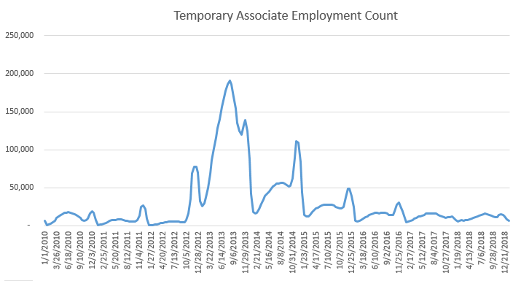
Anomalies, what are they?
- Also go by outlier, novelties, noise, deviations, and exceptions
“a statistical observation that is markedly different in value from the others of the sample” – Marriam-Webster
“An outlier is an observation which deviates so much from the other observations as to arouse suspicions that it was generated by a different mechanism” – Hawkins, 1980

Slide 8
Why should we care?
Fraud Detection
Purchasing behavior of a credit card owner usually changes when the card is stolen. Abnormal buying patterns can suggest a stolen car.
Intrusion Detection
Normal users and internet traffic tends to follow a pretty well defined pattern. A sudden change in the amount of traffic and it’s destination or a rapid change in what the CPU is processing on can indicate a hacker is at work.
Measurement error Detection
Data from sensors may have measurement errors, an abnormal value could provide an indication of measurement error.
Model stability
It screws with your models.
Abnormal values can cause an algorithm to not optimize and skew EDA.
In all cases, you need to decided what to do with Anomalies.

Slide 9
Two classes of models to detect outliers
Supervised:
Supervised model need a data set where all anomalies have been marked as being anomalies. A model is then trained to predict anomaly data points.
K-nearest neighbor
Random Forest
SVM
Unsupervised:
We don’t know ahead of time what an anomaly looks like. Assigns a score to each data point based on all characteristics of either all data points or a local subset of data points.
The main focus of the following section is on unsupervised methods as Isolation Forest are unsupervised.

Slide 10
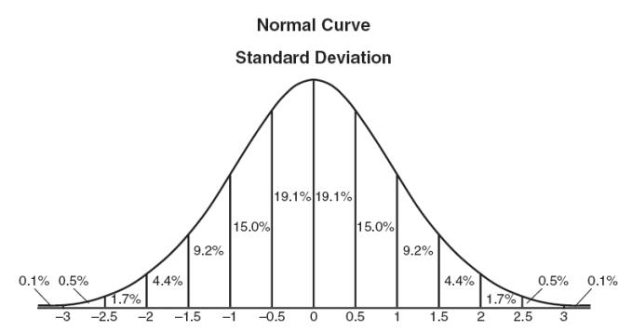
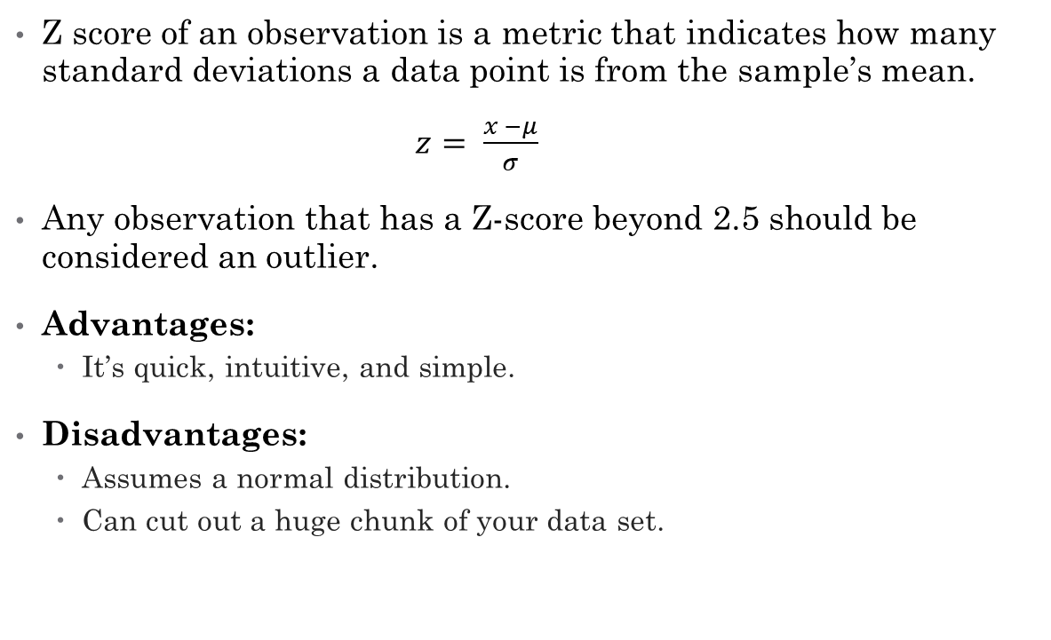
Z - Score
Z score of an observation is a metric that indicates how many standard deviations a data point is from the sample’s mean.
$z= \frac{x −μ}{σ}$
Any observation that has a Z-score beyond 2.5 should be considered an outlier.
Advantages:
It’s quick, intuitive, and simple.
Disadvantages:
Assumes a normal distribution.
Can cut out a huge chunk of your data set.

Slide 11
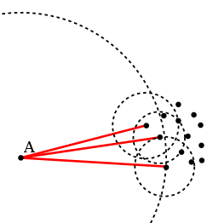
Local Outlier Factor (LOF)
LOF: Identifying Density-Based Local Outliers by Markus M. Breunig, Hans-Peter Kriegel, Raymond T. Ng and Jörg Sander, 2008
LOF is based on a concept of a local density, where locality is given by k nearest neighbors, whose distance is used to estimate the density. By comparing the ratio of the local density of an object to the local densities of its neighbors, one get an LoF Score.
LoF of 1 indicates similar density as it’s neighbor
Lof < 1 indicates a higher density than it’s neighbor
Lof > 1 indicates a lower density than it’s neighbor (an outlier)
Advantages:
Can find outliers in a data set that may not be outliers in another part of the data set
Does not make an assumption about the data.
Disadvantage:
Computation heavy
LoF are relative to a dataset, the average LoF may be 1.5, thus a value > 1 isn’t an outlier.

Slide 12
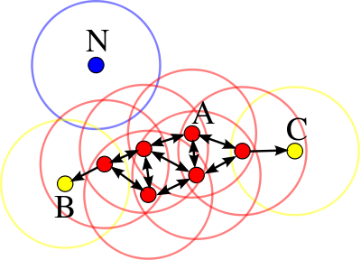
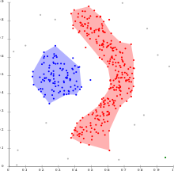
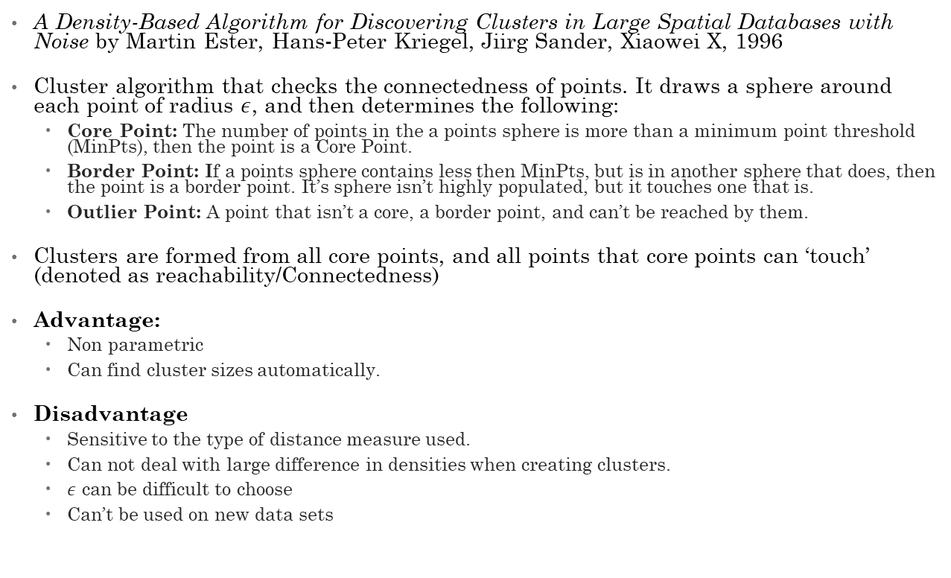
Density-based spatial clustering of applications with noise (DBSCAN)
A Density-Based Algorithm for Discovering Clusters in Large Spatial Databases with Noise by Martin Ester, Hans-Peter Kriegel, Jiirg Sander, Xiaowei X, 1996
Cluster algorithm that checks the connectedness of points. It draws a sphere around each point of radius $ε$, and then determines the following:
Core Point: The number of points in the a points sphere is more than a minimum point threshold (MinPts), then the point is a Core Point.
Border Point: If a points sphere contains less then MinPts, but is in another sphere that does, then the point is a border point. It’s sphere isn’t highly populated, but it touches one that is.
Outlier Point: A point that isn’t a core, a border point, and can’t be reached by them.
Clusters are formed from all core points, and all points that core points can ‘touch’ (denoted as reachability/Connectedness)
Advantage:
Non parametric
Can find cluster sizes automatically.
Disadvantage
Sensitive to the type of distance measure used.
Can not deal with large difference in densities when creating clusters.
$ε$ can be difficult to choose
Can’t be used on new data sets

Slide 13
Section 1: Technical Overview of iTrees and iForest
(The good stuff)

Slide 14

Underlying assumption: Anomalies are easy to slice out.
Anomalies are different and few in number from the rest of the data. Thus they are easy to isolate by relatively few partitions out from the rest of the data.
To make it unsupervised, we need to randomly drawing the partitions.
If we draw the partitions randomly, recursively, and repeatedly, then on average, fewer partitions are needed to isolate a point.

Slide 15
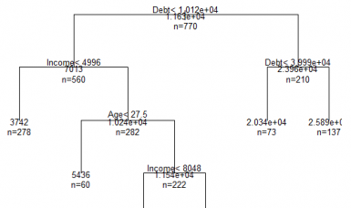

Node
Node: A node splits the data into either two or zero sub groups.
Internal Node: Consists of a test with two outcomes. A test consists of a randomly selected attributed, q, and a random split value, p, that exists between the minimum and maximum values of q. Points are split off to the a left group if $x_{i}$ < p, and to the right group if $x_{i}≥$ p. [Red Box]
External Node: A terminating point with zero subgroups [Blue Box]

Slide 16
Isolation Tree - iTree
Isolation Tree. A collection of internal nodes that recursively feed into other internal or external nodes. An iTree is built by recursively splitting the data via internal nodes until either:
A) There is only one data point left, in which case terminate to an external node
B) The split is one less than the designed tree height, l, in which terminate to two external nodes. Limits the height of the tree to l.
C) All data points are the same, in which case terminate into an external node.

Slide 17
iTree pseudo code
1: def iTree(X, e, l):
2: """ X = input data set, e - current tree height, l - height limit"""
3: if e >= l or set(X).count <= 1:
4: return exNode{Size = set(X).count}
5: else:
6: q = random.choice(X.columns.values)
7: q = random.random(min(X[,q]), max(X[,q)))
8: X_left = filter(X, q < p)
9: X_right = filter(X, q >= p)
10: return inNode{ Left = iTree(x_left, e + 1, l),
11: Right = iTree(x_Right, e + 1, 1),
12: Split_Attribute = q,
13: Split_Value = p}

Slide 18
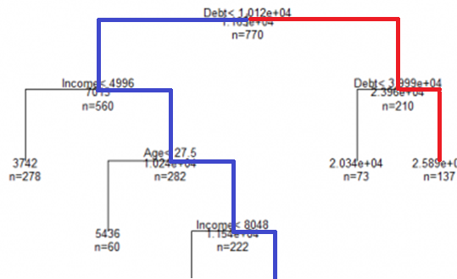

Path Length
Path Length: h(x) of a point x is measured by the number of edges x traverse in an iTree from the root node until a terminal node.
Red has a path length of 2
Blue has a path length of 4
iTree are proper binary trees, thus the average path length of an unsuccessful search (or hitting a external node) is:
$c\left(n\right)≈\left\{\begin{aligned}if n>2: 2Ln\left(n −1\right)− \frac{2\left(n−1\right)}{n}+1.15443 \\ n=2: 1 \\ n<2: 0\end{aligned}\right.$

Slide 19
PathLength pseudo code
1: def PathLength(x, T, pl):
2: """ x = a data point, T – an iTree, pl - current path length"""
3: if T.node is external node:
4: return pl + c(T.node.Size) # Defined previously
5: a = T.node.Split_Attribute
6: if x[a] < T.node.Split_Value:
7: return PathLength(x, T.node.Left, pl + 1)
8: else:
9: return PathLength(x, T.node.Left, pl + 1)

Slide 20
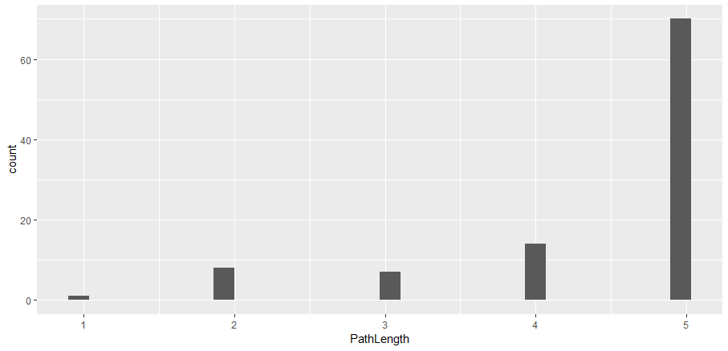
An iTree is not reliable…
You’ll get a different result every time you built an iTree due to the random nature of the iTree building process.
Each tree has a chance of correctly isolating a point, but we don’t if it will or ever.

Slide 21
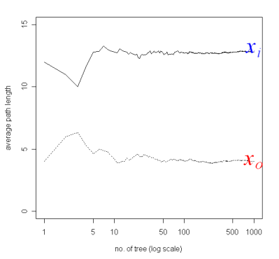
…but an iForest is!
A forest of iTree’s aggregated together provide a reliable average Path Length
Think of the law of large numbers – as we get more iTree’s, the average Path Length should approach the true Path Length.
iForest: a collection of iTree’s that are all built on random samples of the data.
iForest are first built, then each point of data is ran through the iForest to get an anomaly score, which is an adjusted average path length

Slide 22
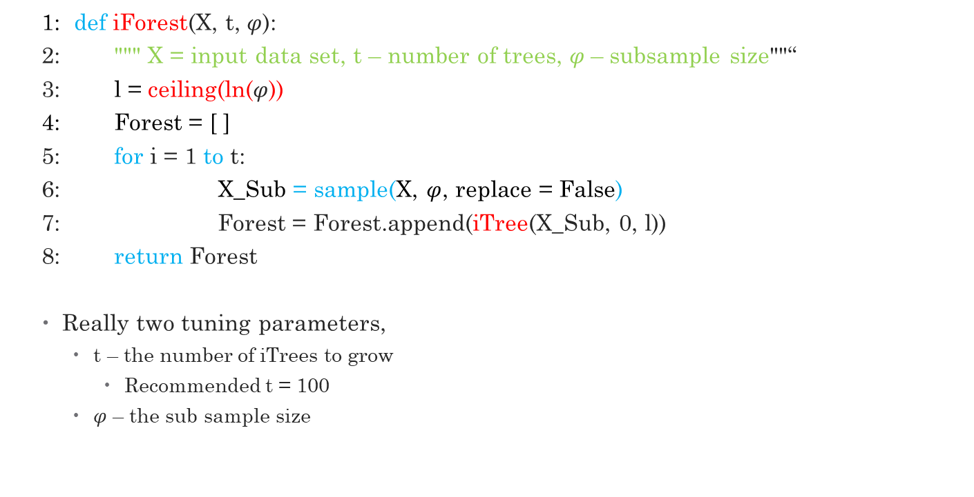
iForest pseudo code
1: def iForest(X, t, $φ$):
2: """ X = input data set, t – number of trees, $φ$– subsample size""“
3: l = ceiling(ln($φ$))
4: Forest = [ ]
5: for i = 1 to t:
6: X_Sub = sample(X, $φ$, replace = False)
7: Forest = Forest.append(iTree(X_Sub, 0, l))
8: return Forest
Really two tuning parameters,
t – the number of iTrees to grow
Recommended t = 100
$φ$ – the sub sample size

Slide 23
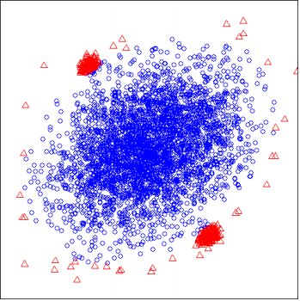

iForest are trained on subsets of the data
Reduces swamping:
Swamping is when a normal point is identified as an anomaly – a false positive.
When several normal points are ‘close to’ an anomaly, it takes longer to separate the anomaly from the normal point
Reduces Masking:
Masking is when an anomaly is identified as a normal point – a false negative.
When we have a cluster of anomalies, they may mask each other.
$φ$ is recommended to be powers of 2 with 256 being the default

Slide 24
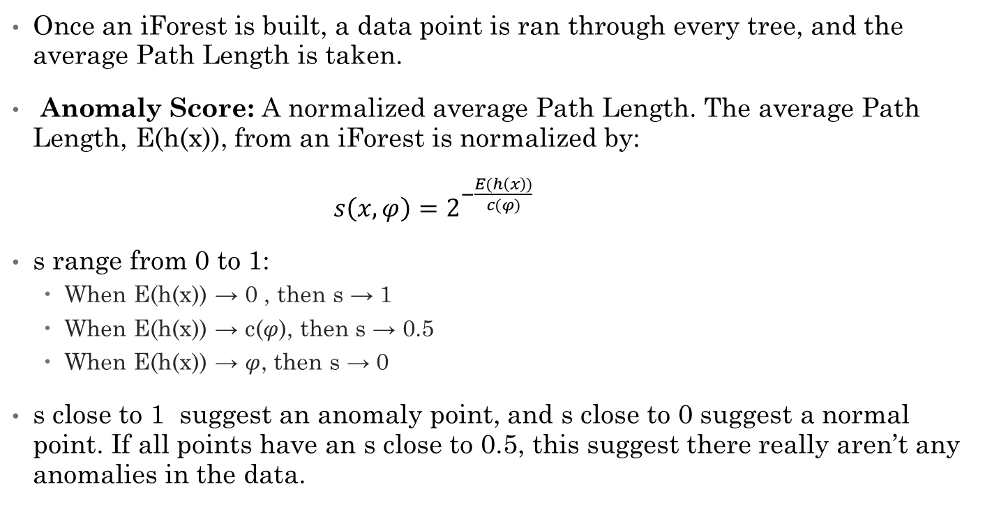
Anomaly Score
Once an iForest is built, a data point is ran through every tree, and the average Path Length is taken.
Anomaly Score: A normalized average Path Length. The average Path Length, E(h(x)), from an iForest is normalized by:
$s\left(x,φ\right)=2^{−\frac{E(h\left(x\right))}{c(φ)}}$
s range from 0 to 1:
When E(h(x)) → 0 , then s → 1
When E(h(x)) → c($φ$), then s → 0.5
When E(h(x)) → $φ$, then s → 0
s close to 1 suggest an anomaly point, and s close to 0 suggest a normal point. If all points have an s close to 0.5, this suggest there really aren’t any anomalies in the data.

Slide 25
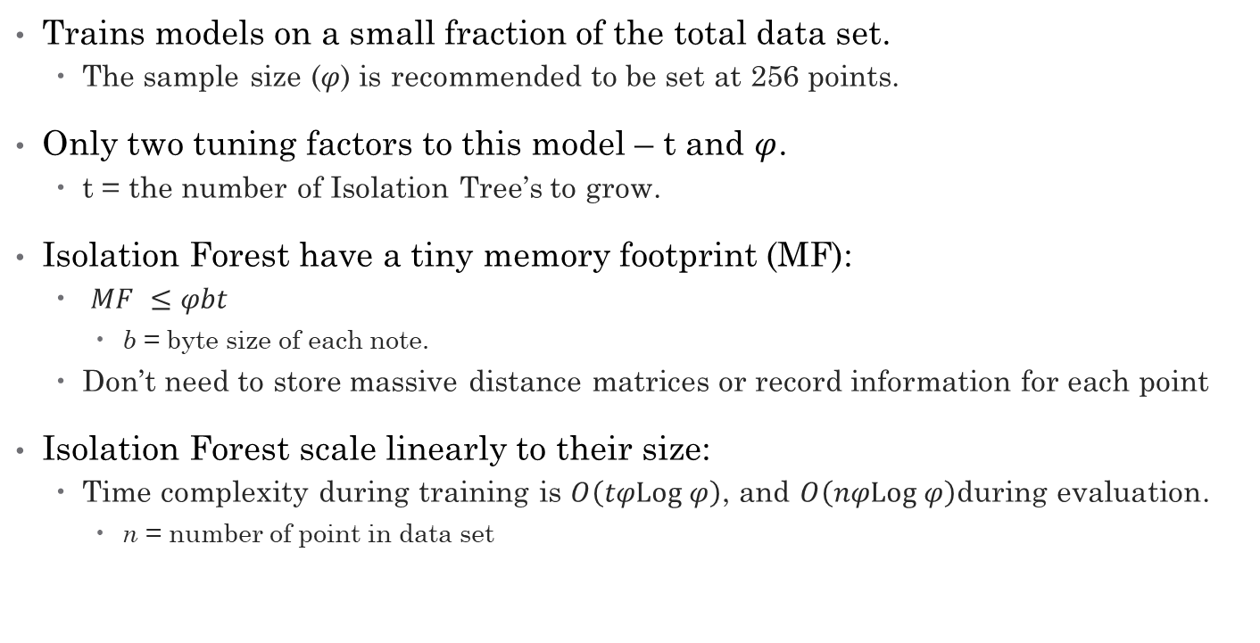
Isolation Forest are Memory and CPU light.
Trains models on a small fraction of the total data set.
The sample size ($φ$) is recommended to be set at 256 points.
Only two tuning factors to this model – t and $φ$.
t = the number of Isolation Tree’s to grow.
Isolation Forest have a tiny memory footprint (MF):
$MF ≤φbt$
b = byte size of each note.
Don’t need to store massive distance matrices or record information for each point
Isolation Forest scale linearly to their size:
Time complexity during training is $O\left(tφLog φ\right)$, and $O\left(nφLog φ\right)\text{during} \text{evaluation}$.
n = number of point in data set

Slide 26
Section 3: Results

Slide 27
We seek these results three.
How does iForest compare to other algorithms?
Compare to ORCA, due to it’s ‘state of art’-iness.
(Similar to knn with randomization and pruning)
Compare to Random Forest, due to it’s forest like structure.
Due to it being a supervised method, synthetic data was constructed from the data set to train and then a proximity measure was used to determine anomalies in the true data set.
Compare to LOF, due to it’s frequent use in Anomaly detection.
2) How does iForest compare with different sub-sampling sizes?
3) How does iForest handle high-dimensional data?

Slide 28
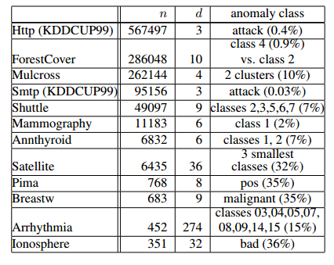
The test data
11 Natural data sets used and 1 synthetic data set.
Picked the data sets because they are frequently used in literature and have known anomalies that can be used as ground truth.
Mulcross is the synthetic data set.
Anomalies labels were not used in training.
All nominal and binary attributes were removed.
n = number of samples
d = dimension of the data

Slide 29
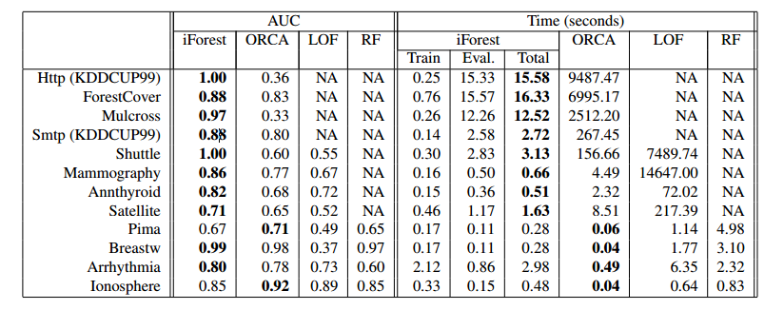
How did iForest compare to other methods?
Super fast on speed for large data sets
Beat ORCA speed for data sets larger than n > 1000
Had a better AUC than practically all others
iForest was only beat twice, by LOF.
RF was reduced to the last 4 sets due to memory constraint
LOF was excluded from the first 4 due to time constraints

Slide 30
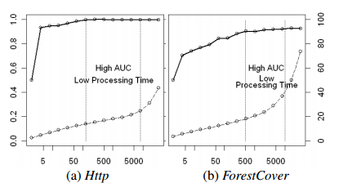
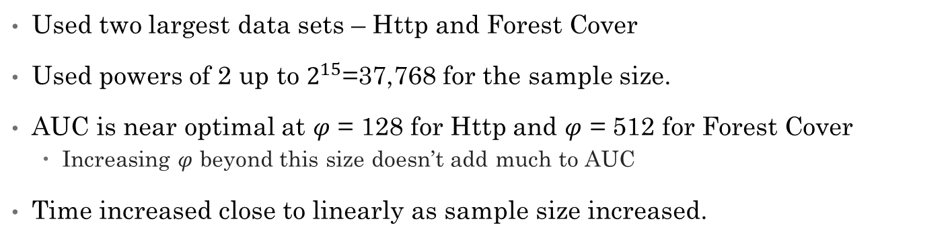
How did iForest compare with different sample sizes?
Used two largest data sets – Http and Forest Cover
Used powers of 2 up to $2^{15}$=37,768 for the sample size.
AUC is near optimal at $φ$ = 128 for Http and $φ$ = 512 for Forest Cover
Increasing $φ$ beyond this size doesn’t add much to AUC
Time increased close to linearly as sample size increased.
Left Axis: AUC
Right Axis: Time (second)
Solid Line: AUC
Dotted line: Time

Slide 31
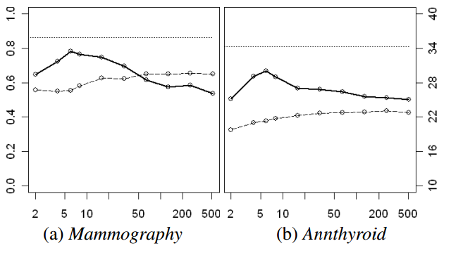
How does iForest handle high dimensional data?
Mammography and Annthyroid data sets had 506 new variables added, using a uniform distribution (between 0 and 1) to create a high dimension data set. Kurtosis was used to find variables with outliers and then variables with high kurtosis where fed into iForest.
iForest performed well and stayed under 30sec run time.
Best AUC is when the subsample equaled the number of variables.
Left Axis: AUC
Right Axis: Time (second)
Solid Line: AUC
Dotted line: Time

Slide 32
In Summary
Super Faster
Super Memory Efficient
Super Effective

Slide 33
Section 4: Discussion

Slide 34
Discuss
Thoughts
What you didn’t like
What you did like
What could be improved upon
What you could use it for

